Slide 2
Time Series Forecasting
BUS391: Special Topics – Financial Modeling

Slide 3
What is Time Series Data?
A series of data points collected in time order
Examples:
Stock prices over time
Airline passenger counts over time
Yearly sea surface temperatures over time
Number of hotel visitors over time

Slide 4
Descriptive vs. Predictive
Descriptive
Predictive
Time series analysis
Time series is modeled to determine its components in terms of seasonal patterns, trends, etc.
Extract meaningful statistics and other characteristics
Time series forecasting
Uses information in the time series to forecast future values of that series
Prospective in nature (looking ahead)

Slide 5
Time Series Forecasting
Performed in nearly every organization that works with quantifiable data
Examples:
Forecasting sales for retail stores
Forecasting energy reserves for energy companies
Forecasting tax receipts and spending for government agencies
Forecasting inflation and economic activity

Slide 6
Time Series Data – Frequency
Can be recorded frequently with assistance of current technology
Examples
Stock prices daily and throughout the day
Internet of Things (IoT) sensor readings every second, minute, etc.

Slide 7
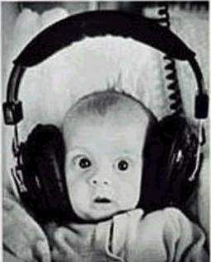
Frequency vs. Noise
More frequent measurements typically mean more noise (variation)
Need to determine the appropriate frequency for the type of forecasting (forecast of monthly sales likely doesn’t need daily sales data)
This Photo by Unknown Author is licensed under CC BY-SA

Slide 8
Time Series Components
Component | Description
Level | Average value of the time series
Trend | Change in the series from one period to the next General direction in which something is developing
Seasonality | Short-term cyclical behavior of the series which can be observed several times within a given time series Pattern that repeats at a regular time interval (every month, every 6 months, etc.)
Noise | Random variation that results from measurement error or other causes not accounted for (always present to some degree in every time series dataset)

Slide 9
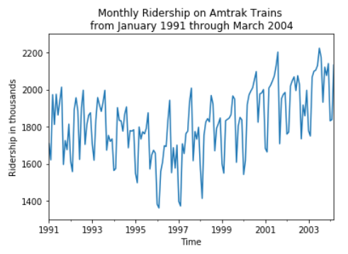
Identifying Components
Visualize the times series
Best approach
Line chart
Values over time
Temporal labels
Known as a time plot

Slide 10
Common Investigation Tools
Tool | Description
Zoom in | Zooming in to shorter time periods within the series can reveal patterns that are hidden when viewing the entire series Especially important when the time series is long
Change scale of series | In order to better identify the shape of a trend, it is useful to change the scale of the series Example: change vertical scale to a logarithmic scale
Add trend lines | By trying different trendlines (linear, exponential, etc.), one can see what type of trend best approximates the data
Suppress seasonality | It is often easier to see trends in the data when seasonality is suppressed

Slide 11
Types of Forecasts
Forecast | Description
Naïve | Use the previous value (t) in the series to “forecast” the current period Also possible to use t + k to handle seasonality within a time series, where k is the length of the seasonal cycle
Moving average | Type of smoothing method Averages values across a window of consecutive periods
Exponential smoothing | Type of smoothing method, popular forecasting method in business Uses an alpha value to weight the past and recent previous values
Multiple linear regression | Based on linear regression Uses predictors (variables) to estimate trend and/or seasonality

Slide 12

Questions?

